Slide 1
Network flow models
A network is an arrangement of paths connected at various points, through which items move.
Networks are popular because they provide a picture of a system and because a large number of systems can be easily modeled as networks.
Network flow models describe the flow of items through a system.
Nodes, denoted by circles, represent junction points connecting branches.
Branches, represented as lines, connect nodes and show flow from one point to another
We will discuss the use of network flow models to analyze three types of problems: the shortest route problem, the minimal spanning tree problem, and the maximal flow problem.
Source: Taylor III (2018)

Slide 2
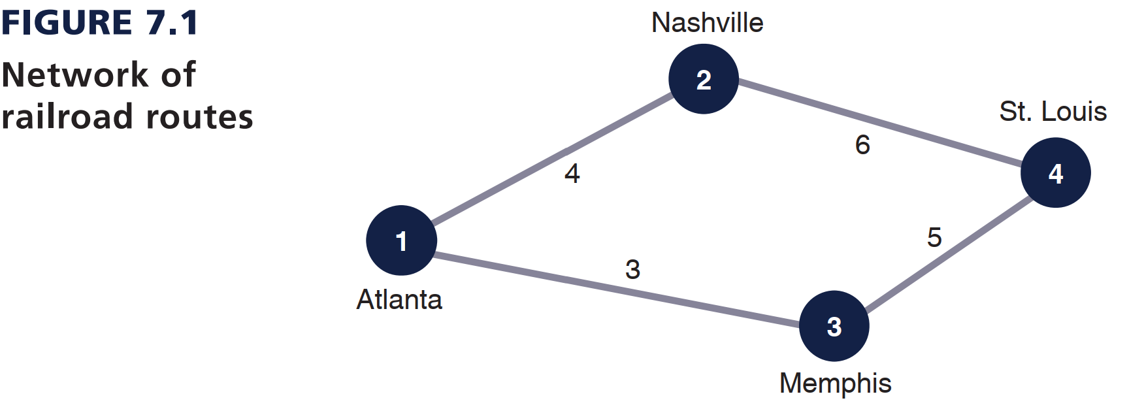
Example of network
Source: Taylor III (2018)

Slide 3
1. The Shortest Route Problem
The shortest route problem is to determine the shortest distance between an originating point and several destination points.
Source: Taylor III (2018)

Slide 4
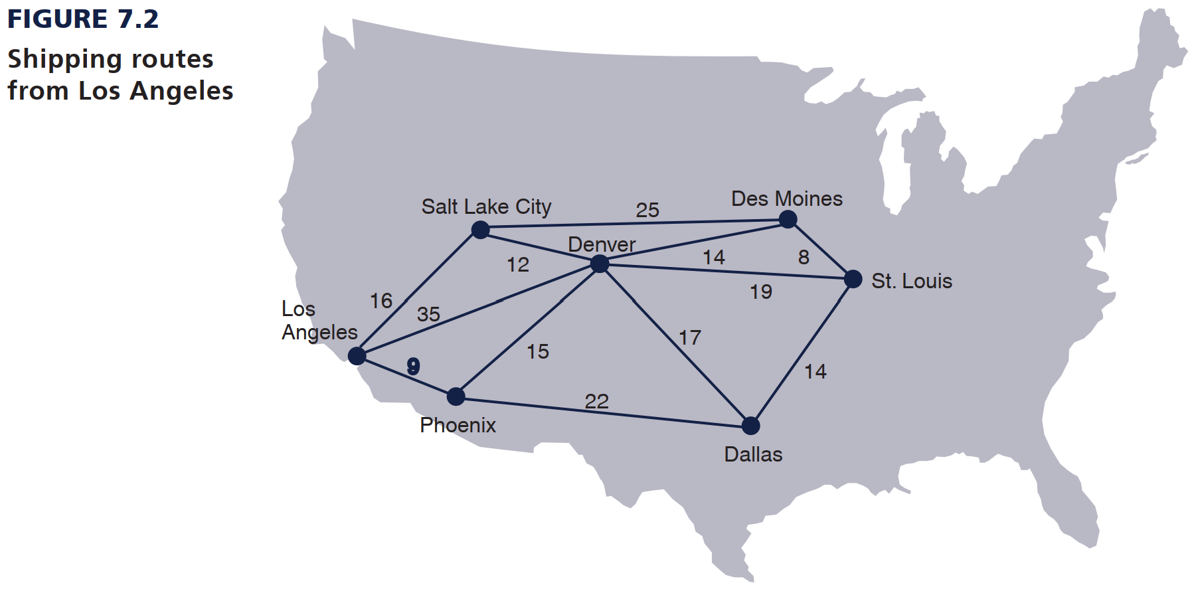
Example 1
The Stagecoach Shipping Company transports oranges by six trucks from Los Angeles to six cities in the West and Midwest. The different routes between Los Angeles and the destination cities and the length of time, in hours, required by a truck to travel each route are shown in Figure 7.2. The shipping company manager wants to determine the best routes (in terms of the minimum travel time) for the trucks to take to reach their destinations.
Source: Taylor III (2018)

Slide 5
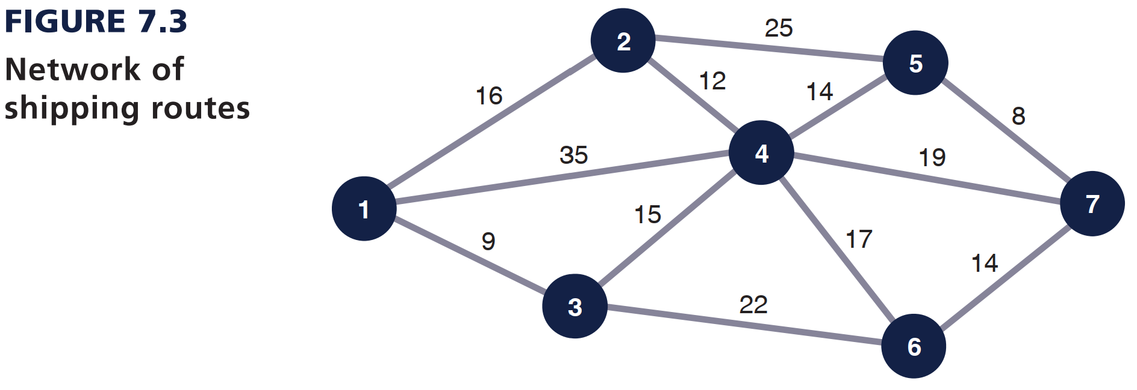
Example 1
Source: Taylor III (2018)

Slide 6
The Shortest Route Solution Approach
Select the node with the shortest direct route from the origin.
Establish a permanent set with the origin node and the node that was selected in step 1.
Determine all nodes directly connected to the permanent set nodes.
Select the node with the shortest route (branch) from the group of nodes directly connected to the permanent set nodes.
Repeat steps 3 and 4 until all nodes have joined the permanent set.
The permanent set indicates the nodes for which the shortest route to a node has been found.
Source: Taylor III (2018)

Slide 7
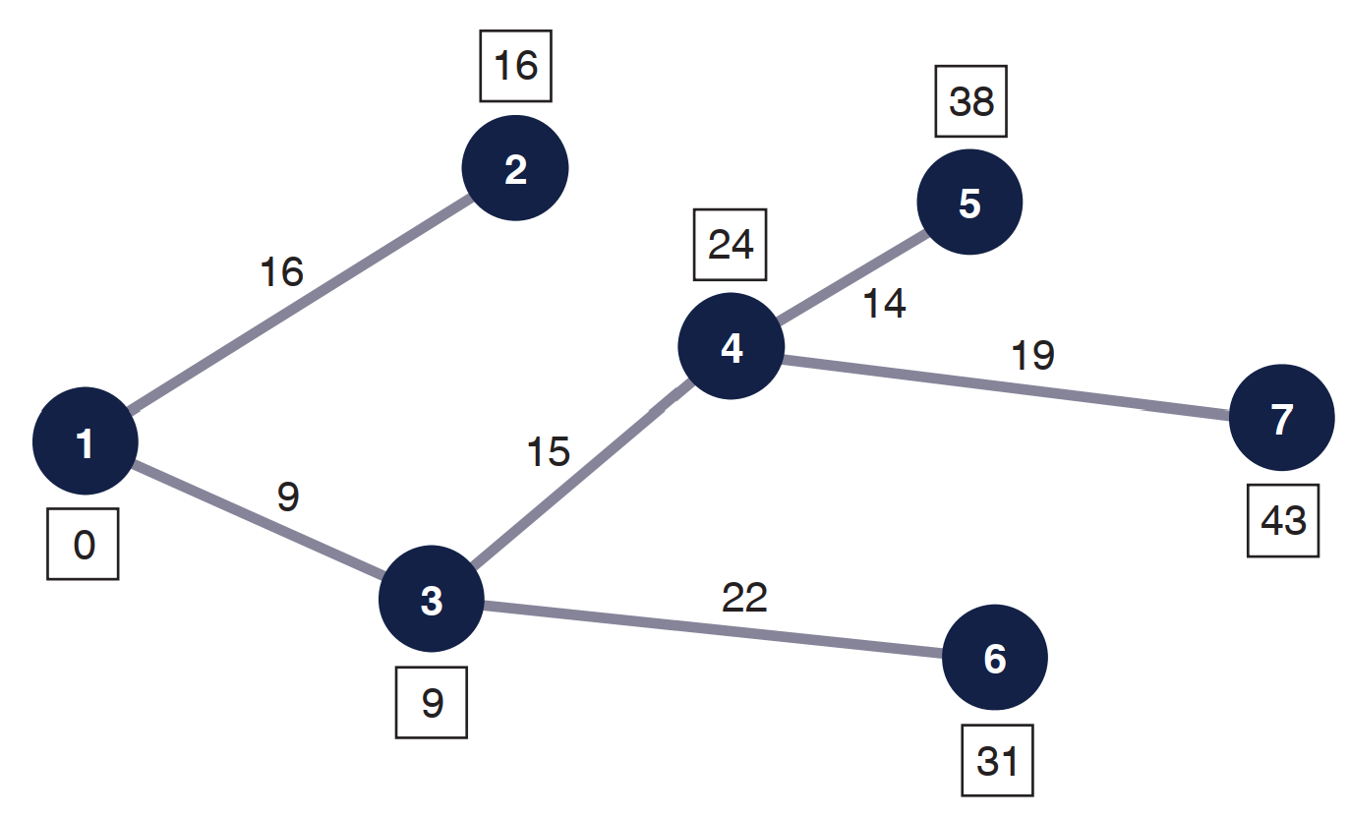
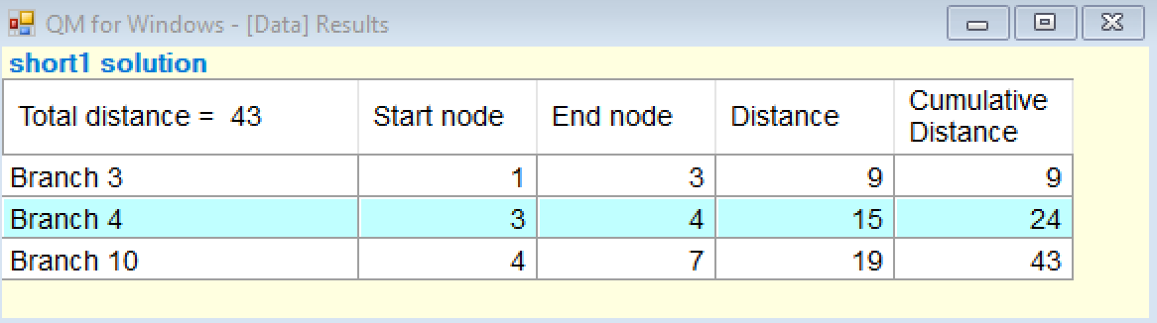
Example 1

Slide 8
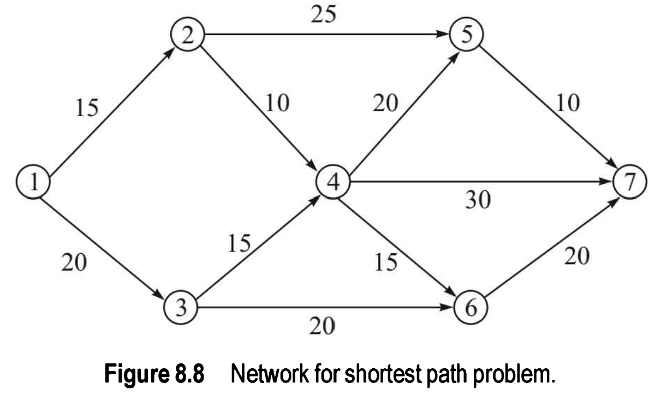
Example 2
Source: Srinivasan (2017)

Slide 9
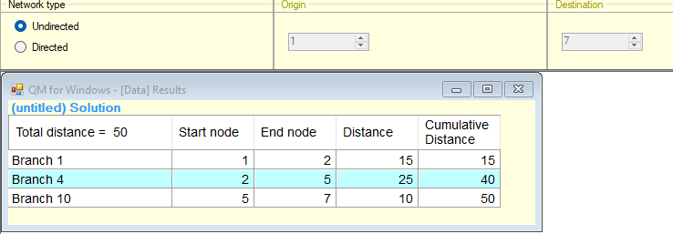

Slide 10
Other instances of shortest route problem
Between a given origin and all points on the network
Between all origins and a single destination on a network
Between a given origin and a given destination passing through a certain node
Between every point and every other point in the network
Second, third and successive shortest paths between a given origin and given destination
Constrained shortest path problems
Source: Srinivasan (2017)

Slide 11
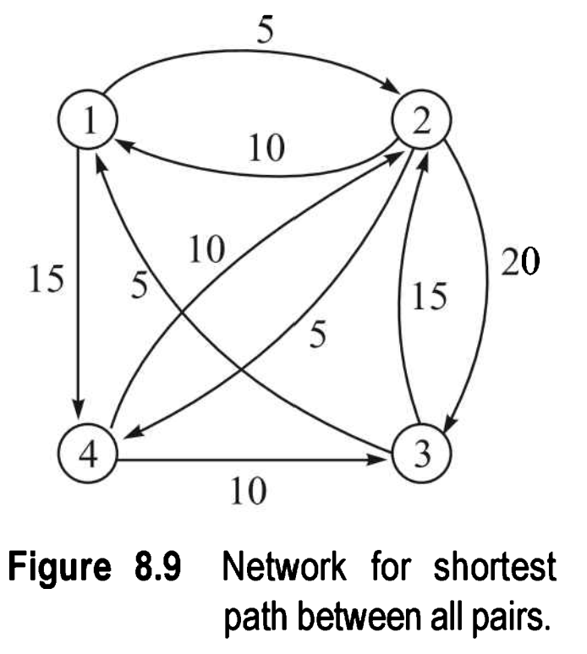
Shortest Route between all Pairs of Nodes in a Network
Find the shortest path among all nodes in the network shown in Figure 8.9.
Source: Srinivasan (2017)

Slide 12
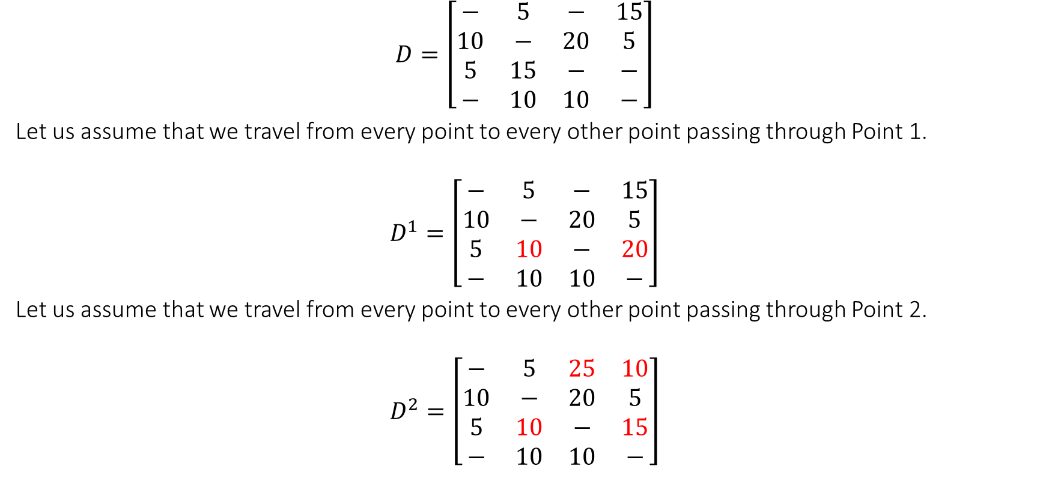
Shortest Route between all Pairs of Nodes in a Network
$$D=\left[\begin{matrix}− & 5 & − & 15 \\ 10 & − & 20 & 5 \\ 5 & 15 & − & − \\ − & 10 & 10 & −\end{matrix}\right]$$
Let us assume that we travel from every point to every other point passing through Point 1.
$$D^{1}=\left[\begin{matrix}− & 5 & − & 15 \\ 10 & − & 20 & 5 \\ 5 & 10 & − & 20 \\ − & 10 & 10 & −\end{matrix}\right]$$
Let us assume that we travel from every point to every other point passing through Point 2.
$$D^{2}=\left[\begin{matrix}− & 5 & 25 & 10 \\ 10 & − & 20 & 5 \\ 5 & 10 & − & 15 \\ − & 10 & 10 & −\end{matrix}\right]$$

Slide 13

Shortest Route between all Pairs of Nodes in a Network
Let us assume that we travel from every point to every other point passing through Point 3.
$$D^{3}=\left[\begin{matrix}− & 5 & 25 & 10 \\ 10 & − & 20 & 5 \\ 5 & 10 & − & 15 \\ 15 & 10 & 10 & −\end{matrix}\right]$$
Let us assume that we travel from every point to every other point passing through Point 4.
$$D^{4}=\left[\begin{matrix}− & 5 & 25 & 10 \\ 10 & − & 15 & 5 \\ 5 & 10 & − & 15 \\ 15 & 10 & 10 & −\end{matrix}\right]$$

Slide 14
2. The Minimal Spanning Tree Problem (MST Problem)
The minimal spanning tree problem is similar to the shortest route problem, except that the objective is to connect all the nodes in the network so that the total branch lengths are minimized. The resulting network spans (connects) all the points in the network at a minimum total distance (or length).
Source: Taylor III (2018)

Slide 15
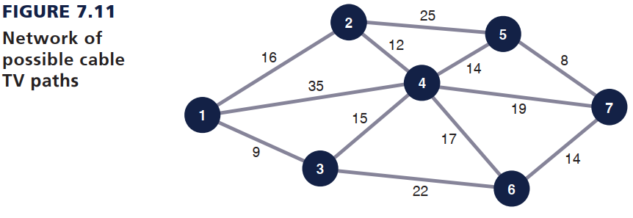
Example 1
The Metro Cable Television Company is to install a television cable system in a community consisting of seven suburbs. Each of the suburbs must be connected to the main cable system. The cable television company wants to lay out the main cable network in a way that will minimize the total length of cable that must be installed. The possible paths available to the cable television company (by consent of the town council) and the feet of cable (in thousands of feet) required for each path are shown in Figure 7.11.
Source: Taylor III (2018)

Slide 16
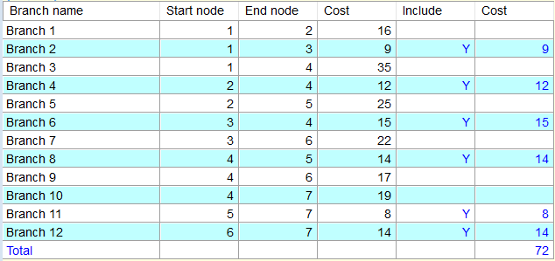
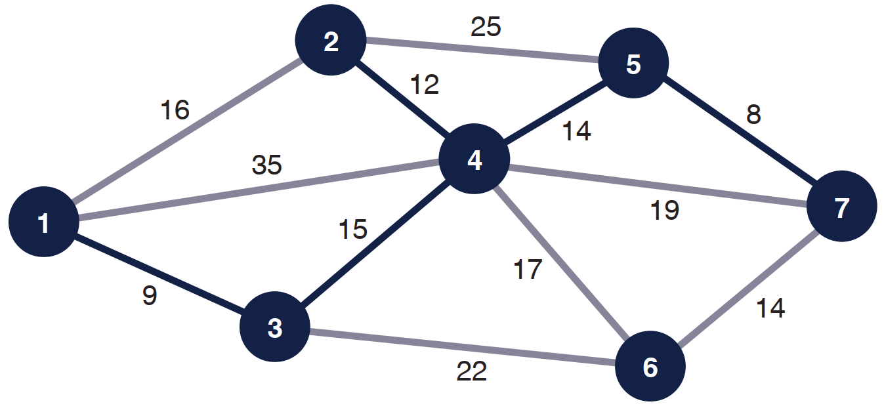
Example 1

Slide 17
The Minimal Spanning Tree Solution Approach
Select any starting node (conventionally, node 1 is selected).
Select the node closest to the starting node to join the spanning tree.
Select the closest node not currently in the spanning tree.
Repeat step 3 until all nodes have joined the spanning tree.
Source: Taylor III (2018)

Slide 18
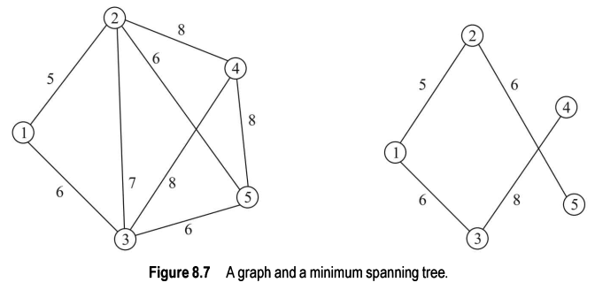
Example 2
Consider the graph given in Figure 8.7 with the weight (cost) shown.
Source: Srinivasan (2017)

Slide 19
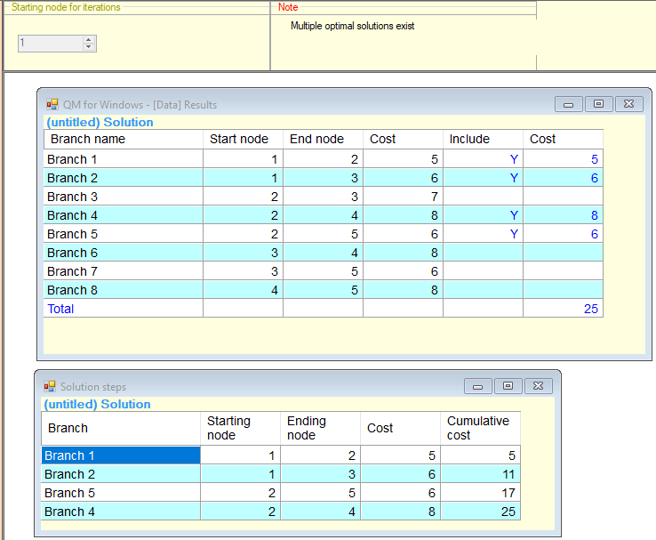

Slide 20
3. The Maximal Flow Problem
There are network problems in which the branches of the network have limited flow capacities. The objective of these networks is to maximize the total amount of flow from an origin to a destination. These problems are referred to as maximal flow problems.
For a directed branch, flow is possible in only one direction.
Source: Taylor III (2018)

Slide 21
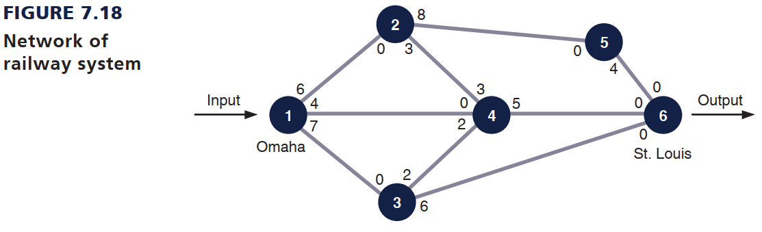
Example 1
The Scott Tractor Company ships tractor parts from Omaha to St. Louis by railroad. However, a contract limits the number of railroad cars the company can secure on each branch during a week.
Given these limiting conditions, the company wants to know the maximum number of railroad cars containing tractor parts that can be shipped from Omaha to St. Louis during a week. The number of railroad cars available to the tractor company on each rail branch is indicated by the number on the branch to the immediate right of each node (which represents a rail junction).
Source: Taylor III (2018)

Slide 22
The Maximal Flow Solution Approach
Arbitrarily select any path in the network from origin to destination.
Adjust the capacities at each node by subtracting the maximal flow for the path selected in step 1.
Add the maximal flow along the path in the opposite direction at each node.
Repeat steps 1, 2, and 3 until there are no more paths with available flow capacity.
Source: Taylor III (2018)

Slide 23
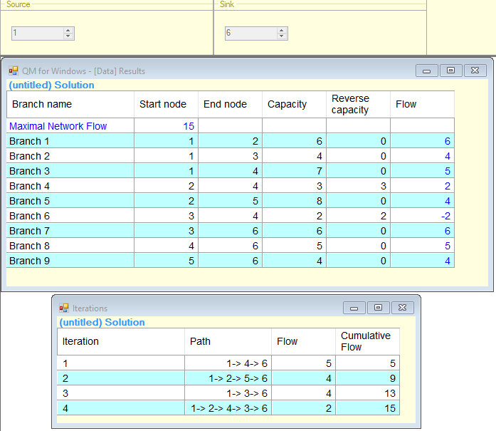

Slide 24
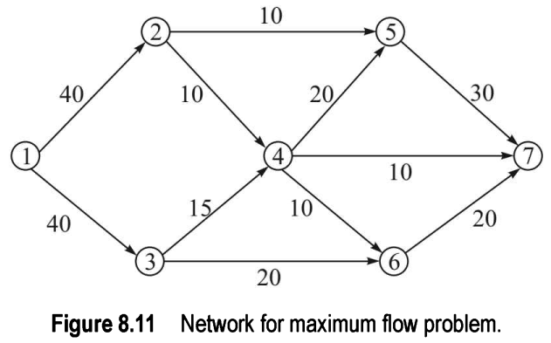
Example 2
Given a capacitated directed network with a source and a sink, the problem is to find the maximum flow that is possible.
Source: Srinivasan (2017)

Slide 25
From the above, we conclude that:
The order in which the paths are chosen is important and different choices can result in different flows.
If we need a good method to solve the problem, it should get the maximum flow, independent of the order in which the paths are chosen.
Finding all paths in a network may be difficult and we should consider those paths that can increase (or augment ) the flow. Such paths are called flow augmenting paths. The algorithm should identify flow augmenting paths in polynomial time.
Source: Srinivasan (2017)

